Slide 1
Cross Site Scripting Attack
Reflected XSS

Slide 2
Cross Site Scripting Attack
Reflected xss is kind of cross-site scripting attack, where malicious script is injected into websites that are trusted or otherwise benign.

Slide 3
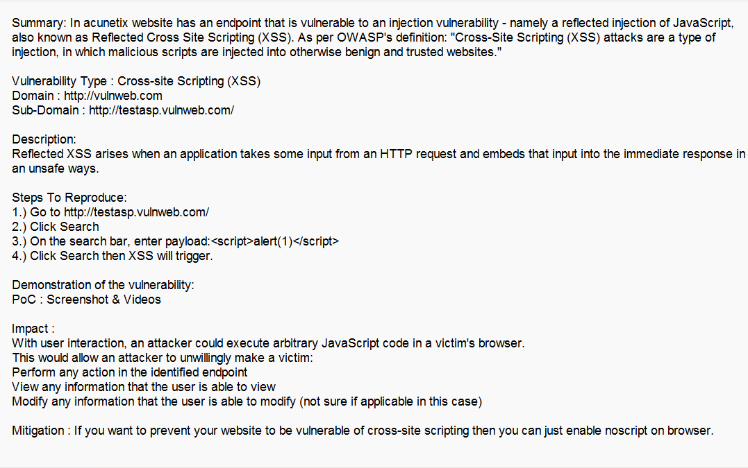
Report of XSS

Slide 4
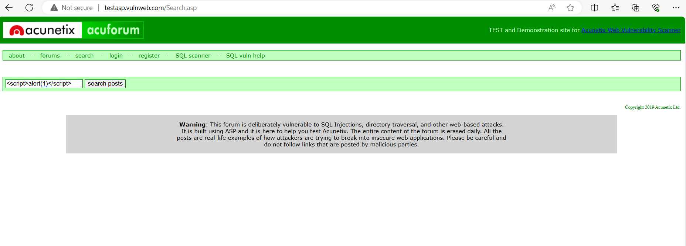
PoC : Screenshot of XSS Vulnerability

Slide 5
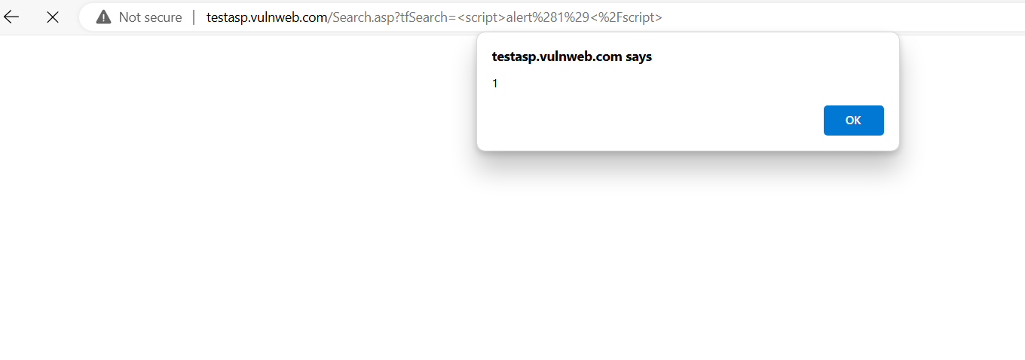
PoC : Screenshot of XSS Vulnerability

Slide 6
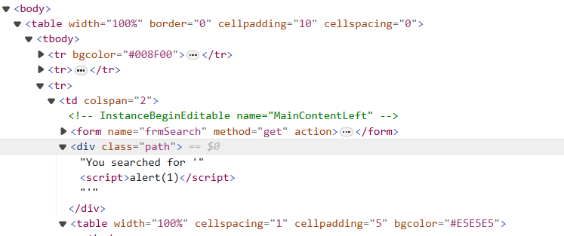
PoC : Screenshot of XSS Vulnerability

Slide 7
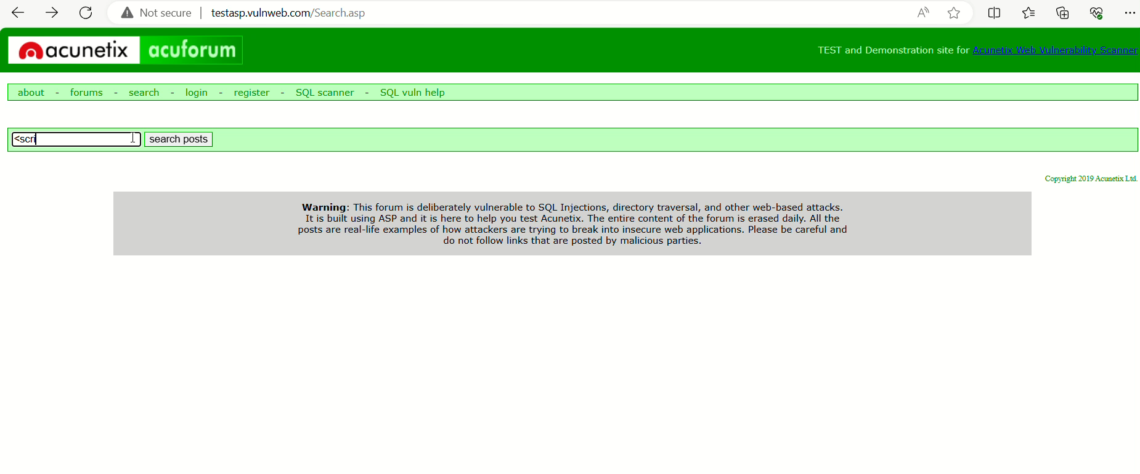
PoC : Video of XSS Vulnerability

